Slide 1
Bank Marketing Dataset - Classification
PRESENTED BY
Sangu Upasana
Sriram Yogendranath
Venkat Reddy
M. Ashwiz
Erram Harshvardhan

Slide 2
About the data : The data is related with direct marketing campaigns of a Portuguese banking institution. The dataset contains many attributes like job , marital status , housing ,etc .
Objective : The goal is to predict wheather the client subscribes to a
Term deposite or not .
Path : Implementing multiple machine learning models to fit the best model for the dataset

Slide 3
Index
Topic | Slide no
Title slide | 1
About the data | 2
Data set | 5
Data cleaning | 6
Exploratory data analysis | 7
Linear regression | 11
Support vector machine (svm) | 12
K-Nearest Neighbors | 13
Decision tree | 14
Random forest | 15
Ada boost | 16
Gradient boost | 17
XG boost | 18
Comparision | 19

Slide 4
summary | 20
Appendix | 21
Thank you | 30

Slide 5
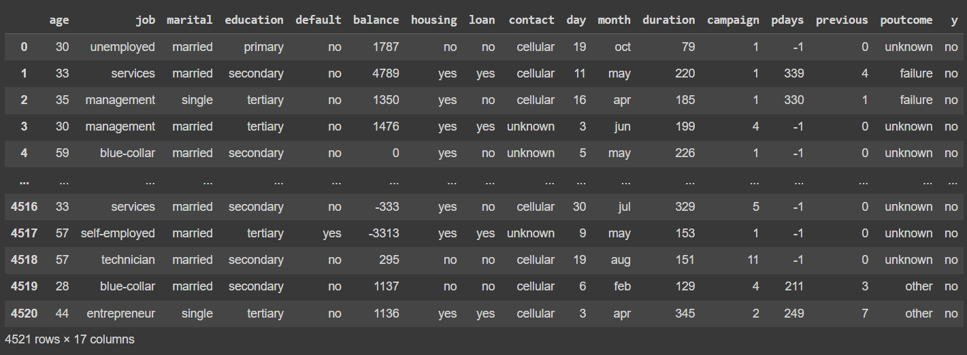
DATA SET

Slide 6
DATA CLEANING
The structure of the data set is in the correct format . The data doesn’t contain any missing values and duplicate values
Dummy variable encoding : mapping binary columns to numerical values and replacing them with 0 & 1 Using map() function .

Slide 7
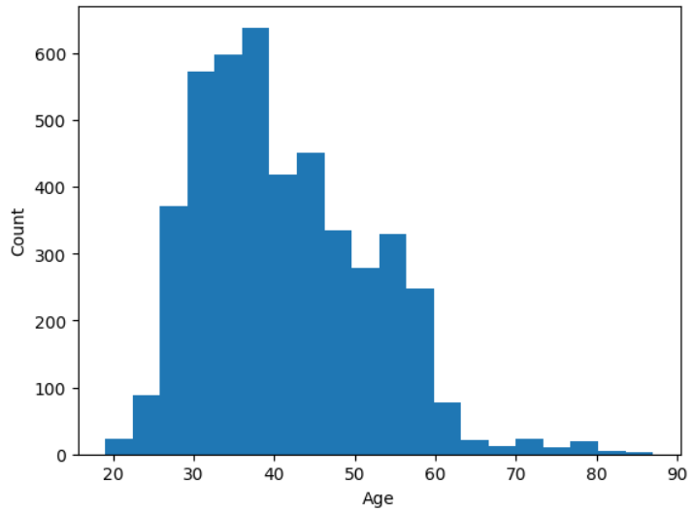
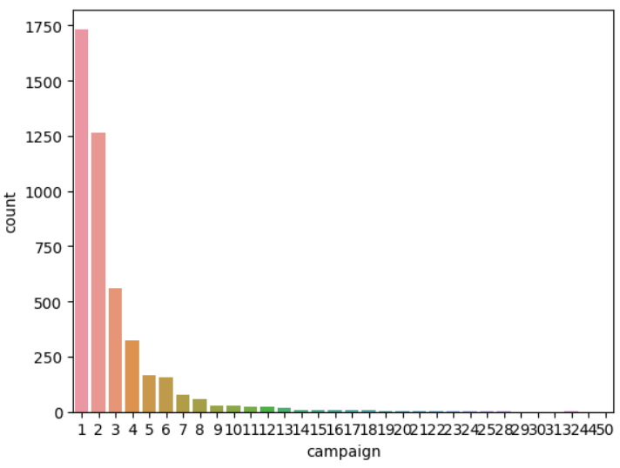
EXPLORATORY DATA ANALYSIS

Slide 8
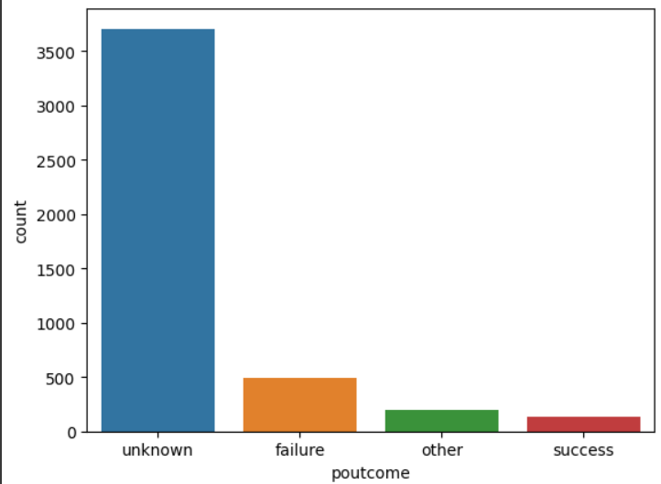
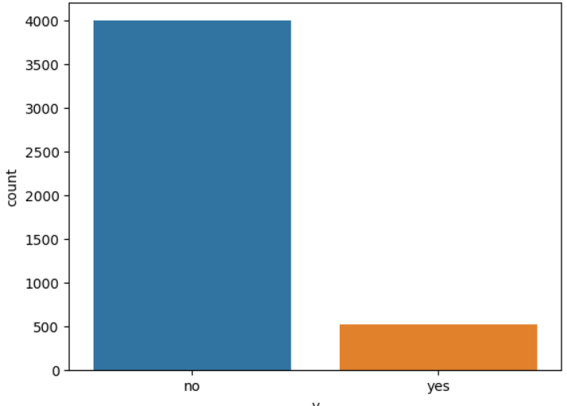

Slide 9
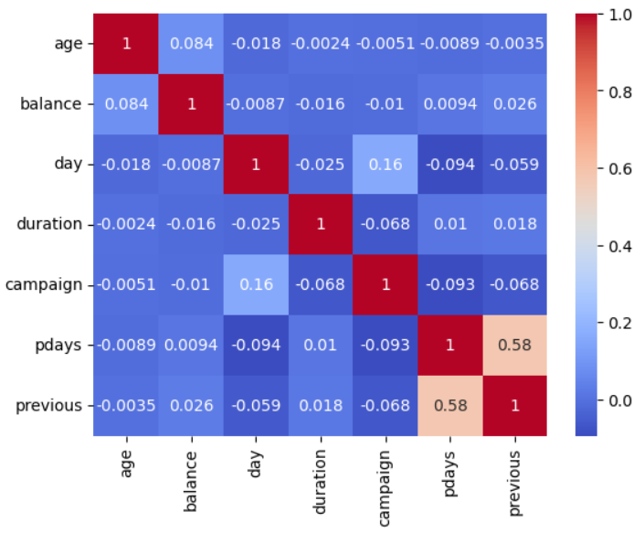
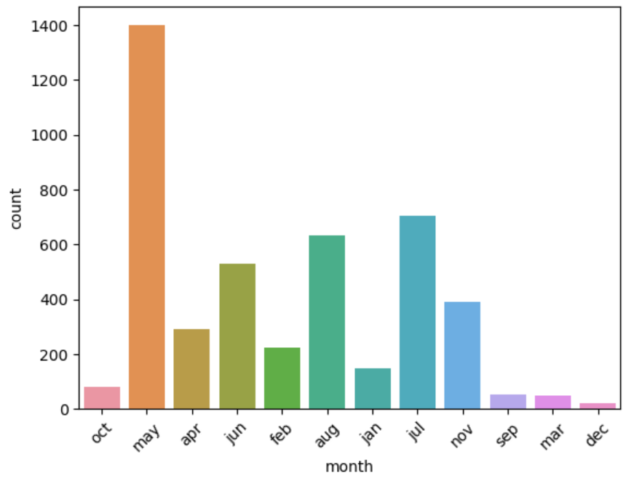
Heat Map

Slide 10
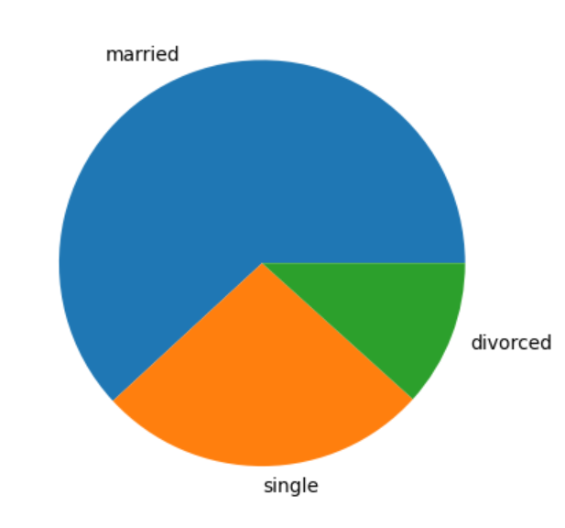

Slide 11
Linear Regression
Train test ratio | Accuracy
65-35 | 0.9368
70-30 | 0.9381
75-35 | 0.9328
80-20 | 0.9271

Slide 12
Support vector machine
Train test ratio | Accuracy
65-35 | 0.8945
70-30 | 0.8946
75-35 | 0.8921
80-20 | 0.8884

Slide 13
K-Nearest Neighbors
Train test ratio | Accuracy | N_neignbor
65-35 | 0.8661 | 3
65-35 | 0.8806 | 5
65-35 | 0.8850 | 7
70-30 | 0.8696 | 3
70-30 | 0.8806 | 5
70-30 | 0.8858 | 7
75-25 | 0.8700 | 3
75-25 | 0.8762 | 5
75-25 | 0.8815 | 7
80-20 | 0.8685 | 3
80-20 | 0.8762 | 5
80-20 | 0.8818 | 7

Slide 14
Decision Tree
Train test ratio | Accuracy | Max_depth
65-35 | 0.9507 | 3
65-35 | 0.9709 | 5
65-35 | 0.9716 | 7
70-30 | 0.9499 | 3
70-30 | 0.9742 | 5
70-30 | 0.9727 | 7
75-25 | 0.9514 | 3
75-25 | 0.9788 | 5
75-25 | 0.9744 | 7
80-20 | 0.9503 | 3
80-20 | 0.9768 | 5
80-20 | 0.9746 | 7

Slide 15
Random forest
Train test ratio | Accuracy | Max_depth | N_estimator
65-35 | 0.8945 | 3 | 100
65-35 | 0.9381 | 5 | 100
65-35 | 0.9697 | 7 | 100
70-30 | 0.8946 | 3 | 100
70-30 | 0.9433 | 5 | 100
70-30 | 0.9690 | 7 | 100
75-25 | 0.8921 | 3 | 100
75-25 | 0.9381 | 5 | 100
75-25 | 0.9682 | 7 | 100
80-20 | 0.8884 | 3 | 100
80-20 | 0.9337 | 5 | 100
80-20 | 0.9702 | 7 | 100

Slide 16
Ada Boost
Train test ratio | Accuracy | Learning_rate | N_estimator
65-35 | 0.9690 | 0.01 | 100
65-35 | 0.9741 | 0.01 | 500
65-35 | 0.9747 | 0.1 | 100
65-35 | 0.9766 | 0.1 | 500
70-30 | 0.9683 | 0.01 | 100
70-30 | 0.9742 | 0.01 | 500
70-30 | 0.9749 | 0.1 | 100
70-30 | 0.9779 | 0.1 | 500
75-25 | 0.9682 | 0.01 | 100
75-25 | 0.9735 | 0.01 | 500
75-25 | 0.9744 | 0.1 | 100
75-25 | 0.9779 | 0.1 | 500
80-20 | 0.9680 | 0.01 | 100
80-20 | 0.9735 | 0.01 | 500
80-20 | 0.9735 | 0.1 | 100
80-20 | 0.9768 | 0.1 | 500

Slide 17
Gradient Boosting
Train test ratio | Accuracy | Max_depth
65-35 | 0.9709 | 3
65-35 | 0.9747 | 5
65-35 | 0.9754 | 7
70-30 | 0.9742 | 3
70-30 | 0.9742 | 5
70-30 | 0.9727 | 7
75-25 | 0.9717 | 3
75-25 | 0.9717 | 5
75-25 | 0.9770 | 7
80-20 | 0.9746 | 3
80-20 | 0.9746 | 5
80-20 | 0.9735 | 7

Slide 18
XG Boost
Train test ratio | Accuracy | Max_depth
65-35 | 0.9728 | 3
65-35 | 0.9773 | 5
65-35 | 0.9747 | 7
70-30 | 0.9764 | 3
70-30 | 0.9742 | 5
70-30 | 0.9742 | 7
75-25 | 0.9717 | 3
75-25 | 0.9770 | 5
75-25 | 0.9717 | 7
80-20 | 0.9702 | 3
80-20 | 0.9735 | 5
80-20 | 0.9724 | 7

Slide 19
Comparision
Linear regression | 0.9271
Support vector machine | 0.8884
K-Nearest neighbor | 0.8661
Decision tree | 0.9499
Random forest | 0.8884
Ada boost | 0.9680
Gradient boost | 0.9709
XG boost | 0.9717

Slide 20
Summary
For the given data we performed eight types of machine learning algorithms : linear regression , support vector machine (svm) , K-nearest neighbor , random forest , decision tree , ada boost , gradient boost and XG boost .
From all the implementation Of the algorithms we found that K-Nearest neighbor is the best algorithm with the parameters of n_neighbor= 3 , for the 65-35 test ratio with accuracy of 15.1396 which is least compared to all other algorithms
Conclusion : We can conclude that random forest is the best algorithm to be considered for the given data student grade prediction

Slide 21
Appendix

Slide 22
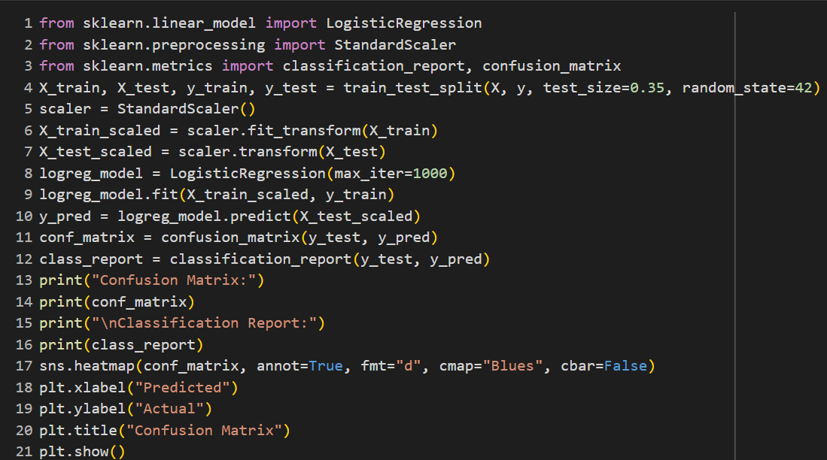
Linear Regression

Slide 23
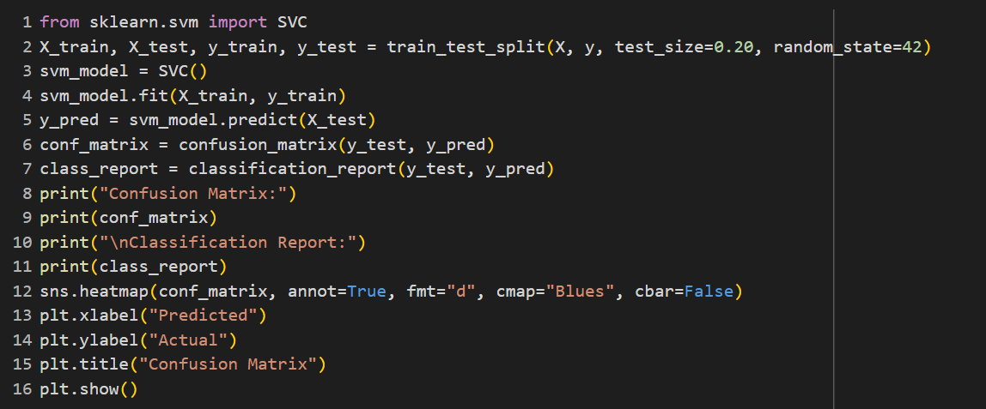
Support vector machine

Slide 24
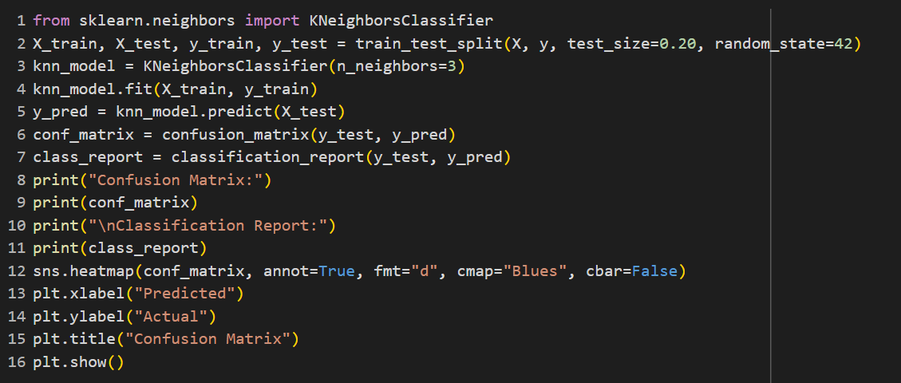
K – Nearest Neighbor

Slide 25
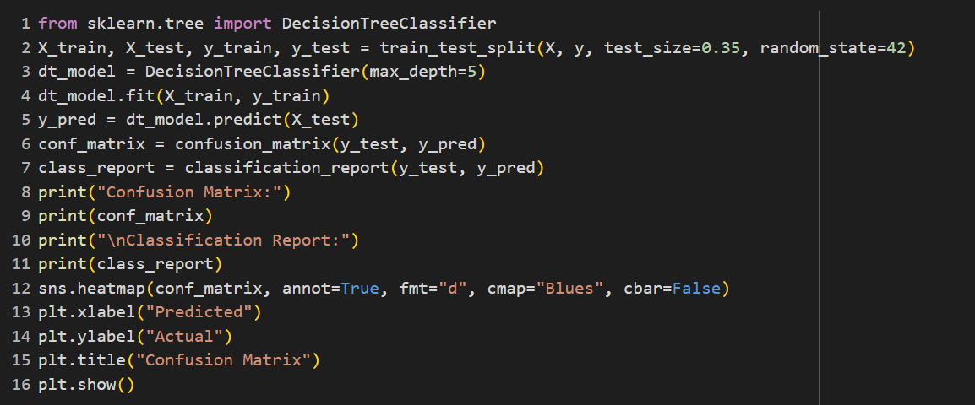
Decision Tree

Slide 26
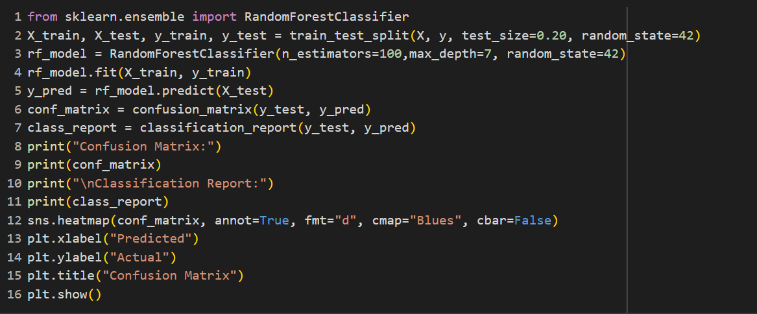
Random forest

Slide 27
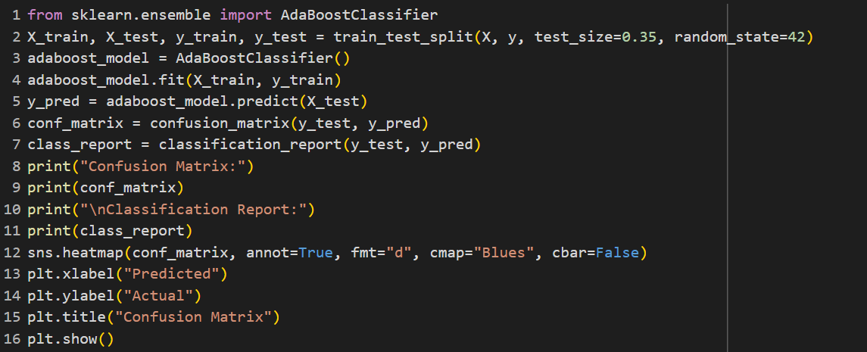
Ada Boost

Slide 28
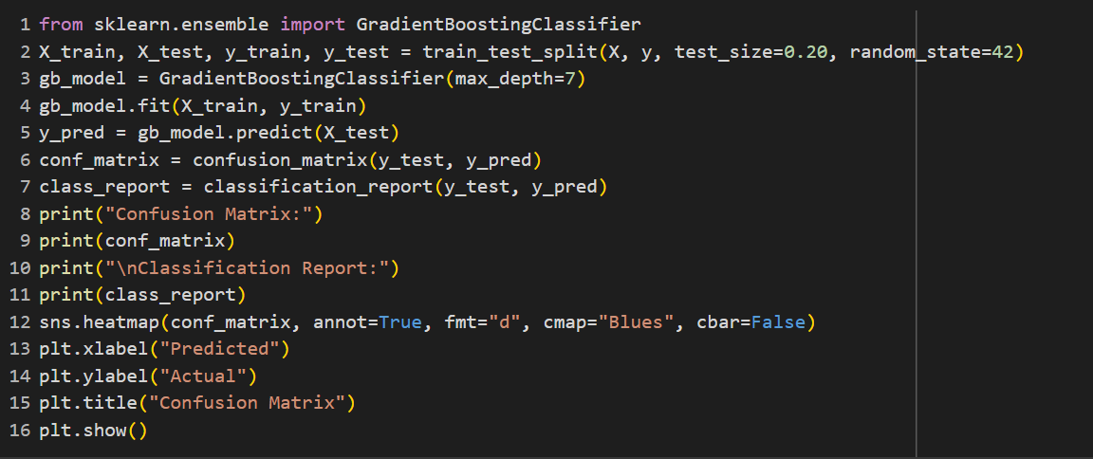
Gradient Boosting

Slide 29
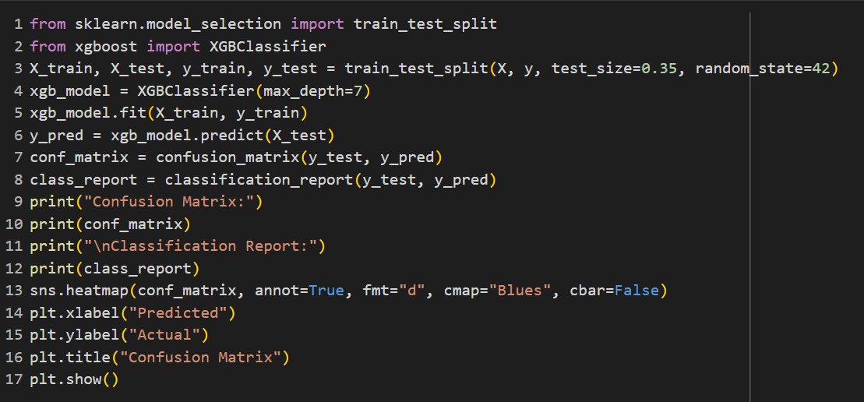
XG Boost

Slide 30
Thank you
Group 5
P . Lohit Satya Sai Venkat Reddy

